Slide 1

How to answer?

Slide 2
Answer questions is the art
Types of questions:
  Concepts
  Technology
  Ideas

Slide 3
How about concepts?
An operating system (OS) is software that manages computer hardware and software resources and provides common services for computer programs. The operating system is an essential component of the system software in a computer system. Application programs usually require an operating system to function.

Slide 4
To give some examples: Windows, Linux, red hat, IOS, etc.
To give a kind of analogy: Home-a house: all the furniture and electronic equipment can be installed
To describe the key words in the concepts: services for computer programs.
Notes:
比喻

Slide 5
Technology
Regular expression to be a convenient notation for specifying lexeme patterns.
Context-free Grammar to describe for the structure of sentences and words.
Question: why we use RE (not CFG) for specifying lexeme patterns?
Notes:
符号，lexeme 词法
正则表达式(RE，Regular Expression；控制流图 CFG

Slide 6
How to answer the ideas
To show your process of solving the problem
To explain the old the idea from which you are inspired

Slide 7
How to answer technology?
To show the difference between your technology and the related technologies
To focus on the difference
To explain the key words again

Slide 8
Conclusion
  the key words of questions
  Steps of answering
    To compare
    To show the difference
    To explain the key words
    To give examples , analogy

Slide 9
Using recommendations for managing trust in distributed systems
Alfarez Abdul-Rahman & Stephen Hailes
Department of Computer Science, University College London
Notes:
分布式系统中利用推荐管理信任

Slide 10
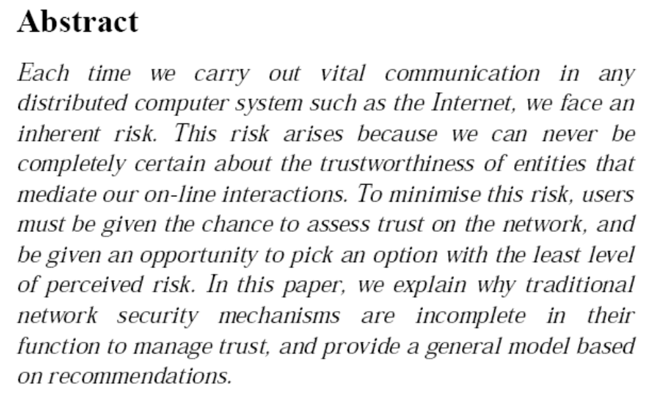

Slide 11
We get？
risk——Uncertainty of trust between entities may halt some real-time interactions
To minimize risk, users can evaluate trust and select the smallest perceived risk
In the traditional trust management, network security mechanism is imperfect
These techniques do not say much about the wider
notion of an entity’s ‘trustworthiness’.
Hence，put forward with the recommendation to solve the problem of trust management
Notes:
动机
风险risk——实体间信任的不确定性可能中止一些实时交互
为使最小化风险，让用户可以评估信任并选取最小的可感知的危险
在信任管理中传统的网络安全机制是不完善的
提出用推荐来解决信任管理的问题

Slide 12
objective
What is trust?
What is recommendation trust?
Trust model
The calculation of trust value

Slide 13
The definition of trust from Wikipedia
In a social context, trust has several connotations. Definitions of trust typically refer to a situation characterised by the following aspects:
One party (trustor) is willing to rely on the actions of another party (trustee); the situation is directed to the future.
In addition, the trustor (voluntarily or forcedly) abandons control over the actions performed by the trustee.
As a consequence, the trustor is uncertain about the outcome of the other's actions; he can only develop and evaluate expectations. The uncertainty involves the risk of failure or harm to the trustor if the trustee will not behave as desired.

Slide 14
Concept
What is trust?
trust (distrust) is a particular level of the subjective probability.
An agent will perform a particular action, and we can monitor such action
Three aspects of the definition of trust:
Trusting is subjective action, not objective
Trusting can affect our behavior
Trust level
Notes:
信任是主观的;信任会影响我们所不能控制的行为;信任的级别依赖于代理的行为如何影响我们的行为
信任的定义的3个层面:

Slide 15
Idea
Motivation
Viewpoints
Trust model
Recommendation agreement
Notes:
outline
信任模型
推荐协议

Slide 16
Keywords
Social society
Dynamic
Subjectivity
Recommendation
Trust/ trusting/trusted
Trustworthy
Reputation
Measurement
Evaluate
Malicious/ vicious/false

Slide 17
Motivation
risk——Uncertainty of trust between entities may halt some real-time interactions
To minimize risk, users can evaluate trust and select the smallest perceived risk
In the traditional trust management, network security mechanism is imperfect
These techniques do not say much about the wider
notion of an entity’s ‘trustworthiness’.
Hence，put forward with the recommendation to solve the problem of trust management
Notes:
动机
风险risk——实体间信任的不确定性可能中止一些实时交互
为使最小化风险，让用户可以评估信任并选取最小的可感知的危险
在信任管理中传统的网络安全机制是不完善的
提出用推荐来解决信任管理的问题

Slide 18
Viewpoint
Using distributed methods for trust management
Generalize the concept of trust
Trust is not delivered
Use clearer trust statements to reduce ambiguity
Exchange trust information through public protocol
Notes:
采用分布式方法进行信任管理
对信任概念进行泛化
信任是不可传递的
使用更清楚的信任语句以减少歧义性
通过公共协议交换信任信息

Slide 19
Distributed: Each entity can choose a trusted party
With decentralisation, each rational entity will be allowed to take responsibility for its own fate.
Trust is not delivered
A trust B, B trust C, can not deduce A trust C
Notes:
分布式：每个实体都可以选择信任方
信任是不可传递的

Slide 20
The generalization of trust
In a trusted operation, which aspects of an entity you trust?
properties属性？
So, produce trust categories and trust values
Recommendation information(name or id of entity, trust category, trust value)
Notes:
信任的泛化
进行信任操作时要明确信任实体的哪个方面，属性？
信任范畴(trust categories)和信任值(trust values)
Recommendation information 推荐信息

Slide 21
Trusting model
Definition
Agent
Trust relationship
Trust category
Trust value
Reputation
Notes:
信任模
代理
信任关系
信任范畴
信任值
信誉
型

Slide 22
Definition
Entity: any object in a network.
Agent: any entity that is capable of making trust-related decisions.
Direct trust: trust in an entity, within a specific category and with a specific value.
Recommender trust: trust in an agent to recommend other entities.
Trust Category: the specific aspect of trust relevant to a trust relationship.
Trust Value: the amount of trust, within a trust category, in a trust relationship.
Reputation: trust information which contains the name of the entity, the trust category, and a trust value

Slide 23
Agent
Agents may recommend any entity, but only agents can make and receive recommendations different from static entities.
Autonomous

Slide 24
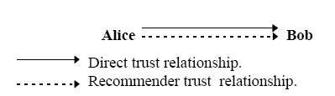
Trust relationship
If Alice trusts Bob, then there is a direct trust relationship. If Alice trusts Bob to give recommendations about other entities’ trustworthiness, then there is a recommender trust relationship between Alice and Bob.

Slide 25
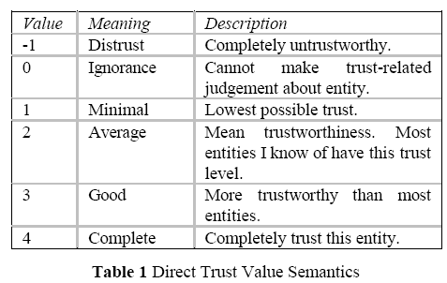
Trust value

Slide 26
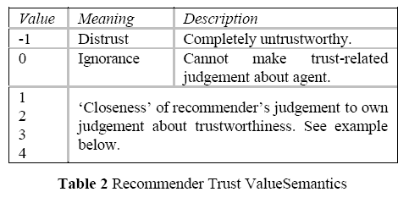

Slide 27
Recommendation protocol
RRQ ::= Requestor_ID, Request_ID,Target_ID, Categories, GetPKC,Expiry
Categories ::= SET OF {Category_Name}
Recommendation ::= Requestor_ID,Request_ID, Target_ID, Return_Path,[Recommendation_slip, TargetPKC |NULL ]
Return_Path ::= SEQUENCE OF {Recommender_ID}
Recommendation_slip ::= SET OF SEQUENCE
{Category_Name, Trust_value,Expiry}
Refresh ::=Target_ID,Recommendation_chain,
Recommendation_slip
从推荐者到请求者的路径

Slide 28

can Alice trust Eric the mechanic?
Alice sends an RRQ to Bob because she trusts Bob as a recommender for car servicing mechanics,
and Bob trusts Cathy in a similar capacity.
Since Bob cannot say anything about Eric with respect to “Car_Service”,
Bob forwards Alice's RRQ to Cathy who may know. Cathy in fact knows about Eric’s workmanship, and Cathy believes that Eric‘s reputation for it is good, i.e. in Cathy’s opinion, Eric’s trust value with respect to category “Car_Service” is 3.

Slide 29
How to calculate trust value
tv_{p}(T) = tv(R₁)/4 × tv(R₂)/4 × .. ×tv(R_{n})/4 × rtv(T)
tv(R_{i}): 推荐者的信任值
rtv(T): 目标T的推荐信任值
tv_{p}(T): 从路径p获得的对目标T的信任值
tv(T)= Min(tv₁(T),…,tv_{n}(T))

Slide 30
Conclusion
Key words: What is trust?
Compare：recommendation trust?
Explain Trust model
Example:The calculation of trust value

Slide 31
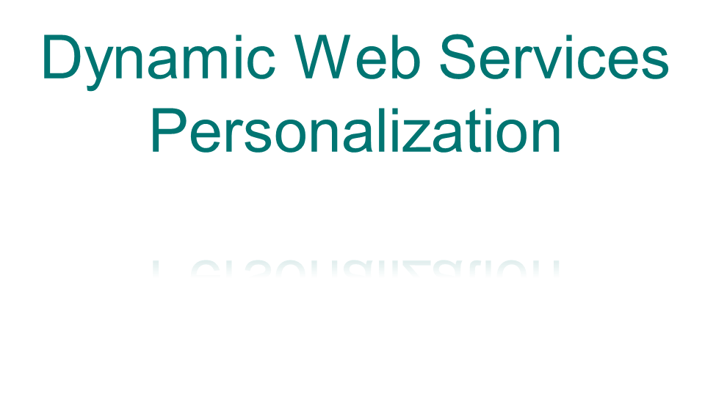
Notes:
个性化动态网络服务

Slide 32
What is personalization?
Dynamic
Personalization
Customization
Paradigm
Heterogeneous resource
Homogeneous resource
Constraint
Composition
Threshold
Cover axiom
Configuration
Context
Matchmaking

Slide 33
LARKS Language
➔描述和请求Web服务的语言
Context(上下文) - 描述请求的关键字
Type(类型) - 定义详细说明中抽象的数据类型
Input/Output(输入/输出)：Web服务调用时，传入和传出的参数
InConstraints/OutConstraints(输入约束/输出约束)
Web Service Customization

Slide 34
keywords
interoperability
deficiency
preference
taxonomy
profile information
scenario
envision
diversity
composition/decomposition
on the fly
exemplify
互用，协作性
不足
喜好
分类
概貌信息
剧本 情景
设想 预见
多样化，多样性
组合/分解
根据需要，动态地
例证，举例说明

